Slide 1






Team BabyBara HackRift
Team Members
Adrian Pang
Ariel Yong
Ryan Chua
Xavier Ong
Teo Zhikai

Slide 2



Table of contents
01
02
03
Problem Statement
Market
Solutions
Our Solution

Slide 3

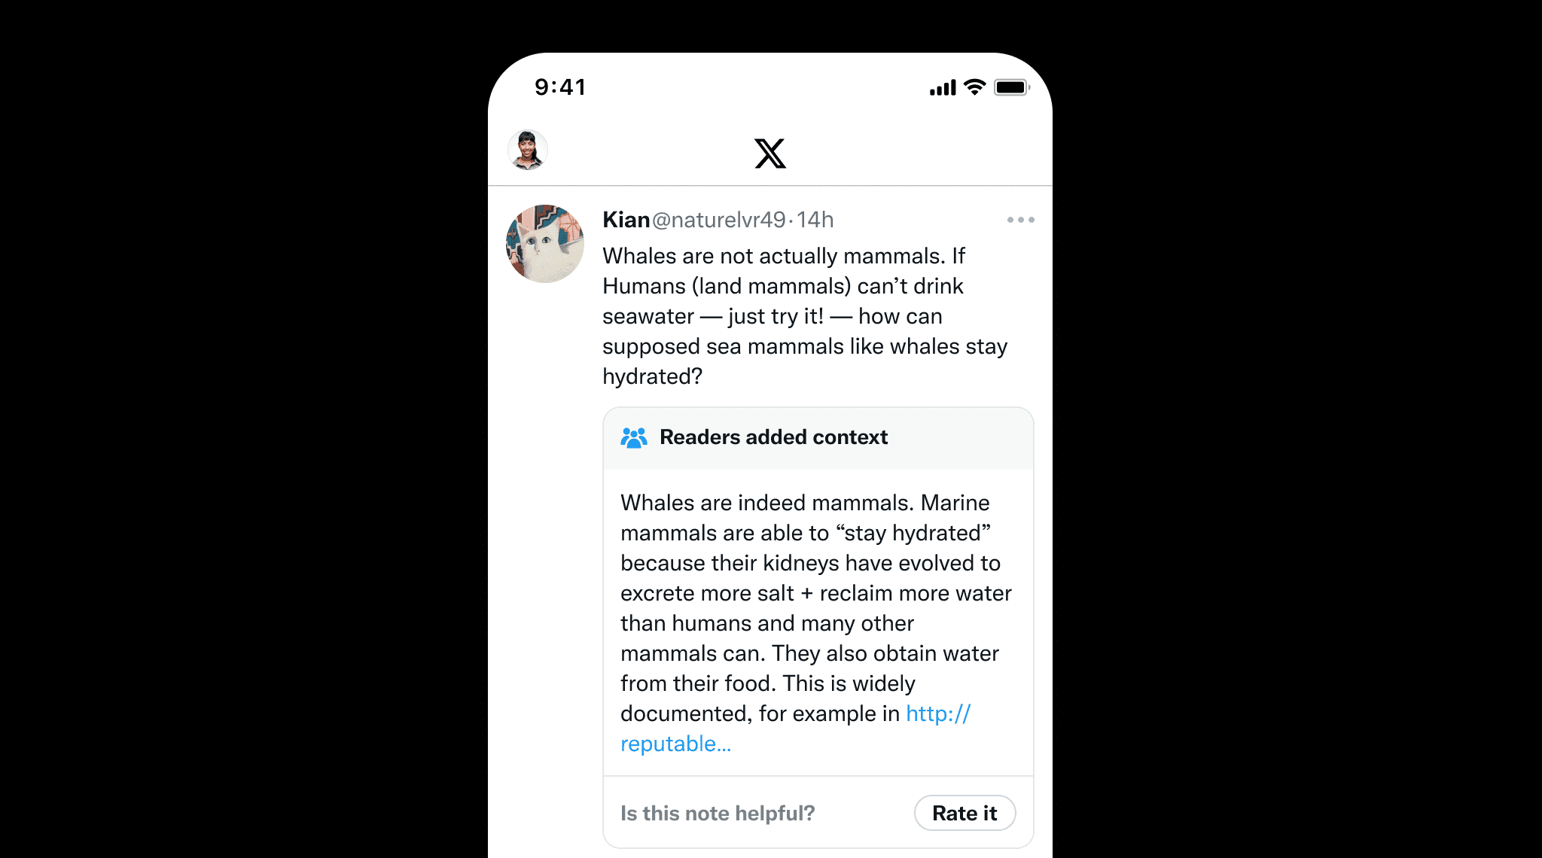
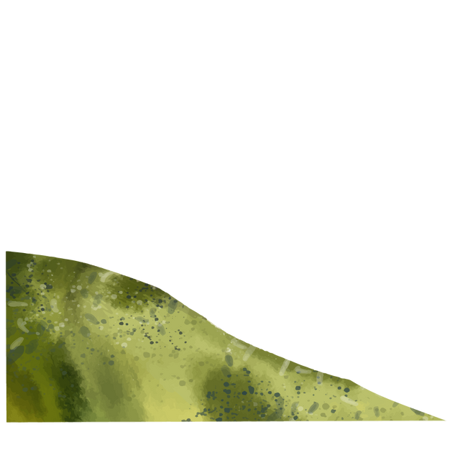

Problem Statement
User-generated content often lacks verification, leading to the spread of misinformation.
Challenges:
Content can appear credible but is factually incorrect.
Misinformation spreads quickly due to lack of oversight or validation.
Audiences may struggle to discern accurate from inaccurate information.
Source: https://www.mysmartprice.com/gear/internet/internet-features/twitter-community-notes-explained/

Slide 4
Market Solutions
X (formerly Twitter)
A crowdsourced fact-checking system where users collaboratively annotate misleading content.
Notes are displayed publicly to provide additional context and address misinformation.
Limitations:
Fact-checking is performed by peers rather than professionals (Gao, Zhang, & Rui, 2024).
Community Notes addressed only 26% of misleading posts about the U.S. elections, highlighting scalability issues (Ortutay, 2024).
Source: https://www.mysmartprice.com/gear/internet/internet-features/twitter-community-notes-explained/

Slide 5

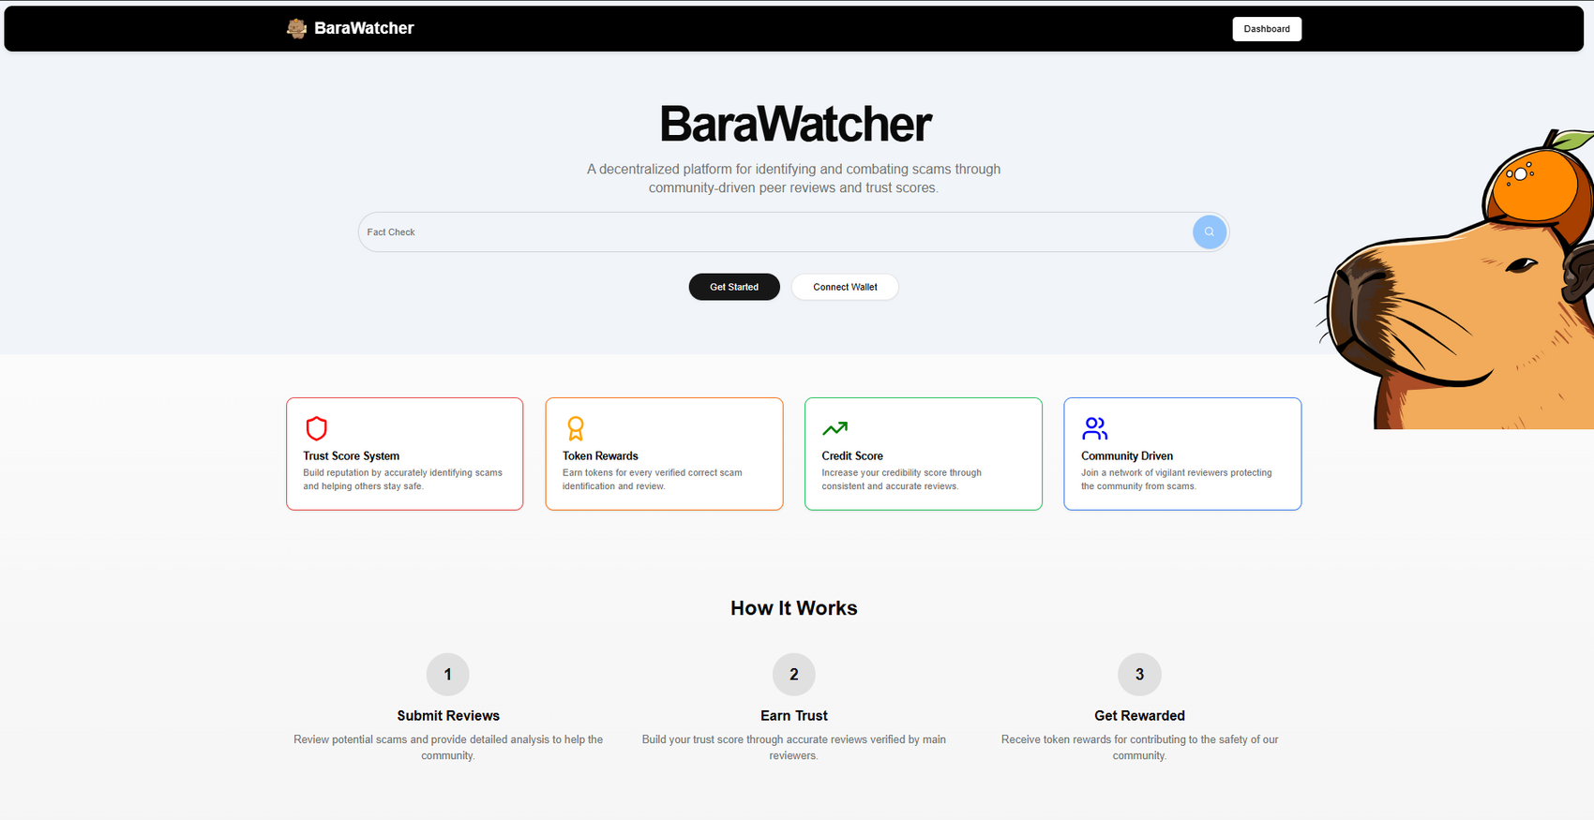
Our Solution

Slide 6
Our Solution
BaraWatcher is a decentralized platform that leverages community validators and trusted validators to collaboratively combat misinformation while ensuring transparency and fairness through smart contracts. Its cloud-based, scalable system incentivizes contributors with tokenized rewards and provides reliable, verified content via API integration.

Slide 7




Our Solution
Global Contributions
Introduce Trusted Validators
Cloud Based API
Users will be able to submit User Generated Content (UGC) to BaraWatcher to fetch relevant community notes.
Our solution encourage users worldwide to contribute notes and votes for rewards due to the reward system nature with smart contract and tokenization
Unbiased Contributions as community members are inclined to accurately write notes or vote for more rewards and reliability score

Slide 8
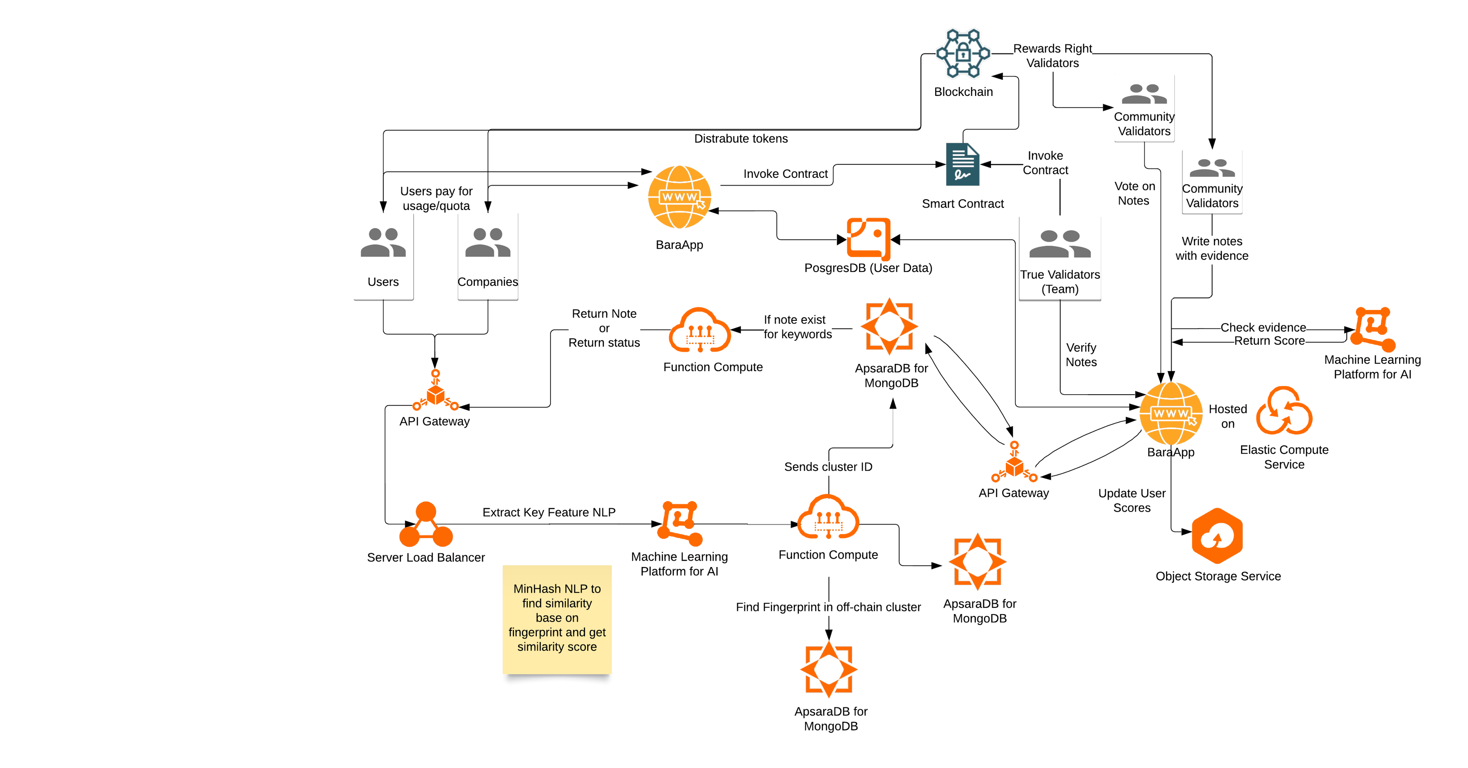
Architectural Diagram

Slide 9


Slide 11


Novelty
Highly Scalable
Tokenized
Our solution is a modular cloud native approach where resources are pay as you use through API
Users are more likely to contribute properly, and API users can pay a fair price based on supply and demand

Slide 12

Thanks!
Team BabyBara

Slide 13
References
[1] Gao, Y., Zhang, M., & Rui, H. (2024). Can crowdchecking curb misinformation? Evidence from community notes. SSRN. http://dx.doi.org/10.2139/ssrn.4992470
[2] Ortutay B. X fails to address majority of misinformation posts, says watchdog. AP News. October 31, 2024. Accessed December 9, 2024. https://apnews.com/article/x-musk-twitter-misinformation-ccdh-0fa4fec0f703369b93be248461e8005d

